Slide 1
Stock Price Prediction
Submitted in the partial fulfillment for the award of the degree of
BACHELOR OF ENGINEERING
IN
Computer Science Engineering - Big Data Analytics
Submitted by:
Ashrith Ravikanti, 20BCS4378
Chandrasekhar 20BCS4428
Tushar Bhardwaj 20BCS3841
Yash Rana 20BCS6798
Jaitanya 20BCS6139
Under the Supervision of:
Mr.Kushagra Agarwal
Department of AIT-CSE
DISCOVER . LEARN . EMPOWER

Slide 2
Outline
Introduction to Project
Problem Formulation
Objectives of the work
Methodology used
Results and Outputs
Conclusion
Future Scope
References

Slide 3
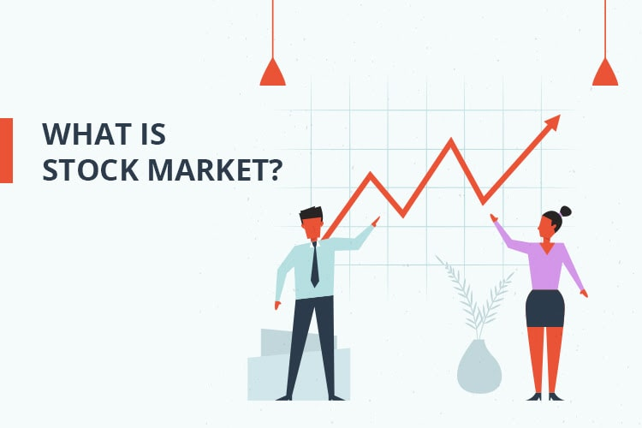
Introduction to Project
A Stock is a security that represents the ownership of a fraction of the issuing corporation.
Stock Market is a public entity for trading of company stocks (shares).

Slide 4

STOCK PRICE PREDICTION
Stock price prediction aims to determine the future movement of the stock value of a financial exchange.
The accurate prediction of share price movement will lead to more profit investors can make.

Slide 5

Problem Formulation
The rate of investment in Stock Market is very low due to lack of knowledge and availability of other Financial instruments.
Stock Price Prediction
Minimize the losses
Helpful for Amateurs
Develop the habit of complete analysis.

Slide 6

Objectives of the Work
The objective of the proposed work is to study and improve the deep learning algorithms to predict the stock price.
Technical part is performed in jupyter notebook using Python and its libraries.

Slide 7
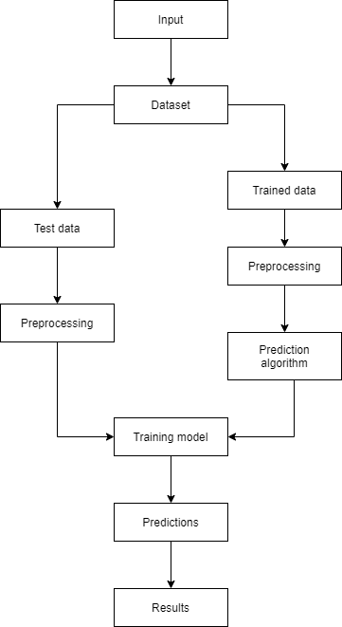
Methodology used
Data Splitting Phases:
Stock Price Dataset
Data Processing & Cleaning
Training Data
Testing Data
Data Training Phases:
Training data
Define LSTM Model
Testing & Evaluation Phases:
Test Data
Train Model
Final Output
Error Count / Comparison

Slide 8
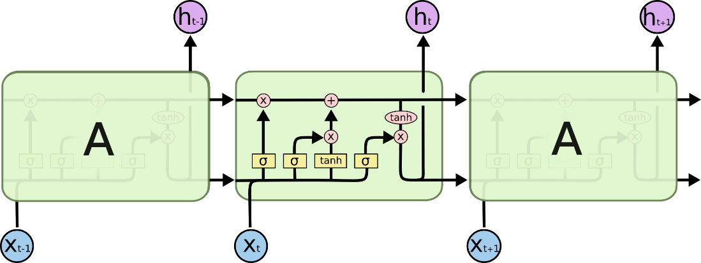
Long Short Term Memory
Long short-term memory network (LSTM) is a particular form of recurrent neural network (RNN).
LSTM is used instead of RNN to avoid exploding and vanishing gradients.
LSTMs are widely used for sequence prediction problems and have proven to be extremely effective.
LSTM can store past important information and forget the information that is not needed.

Slide 9
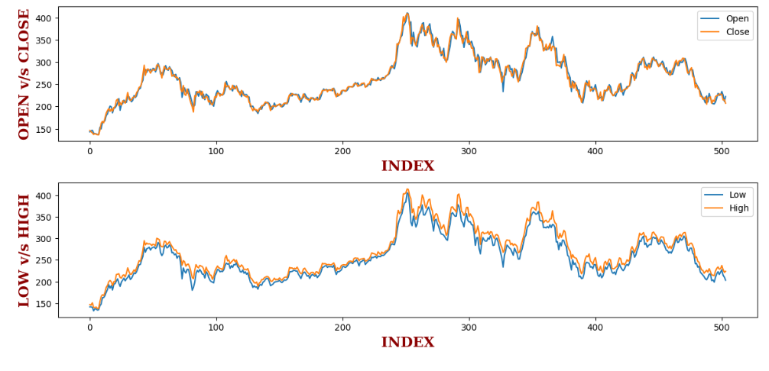
Results and Outputs
OPEN vs CLOSE

Slide 10
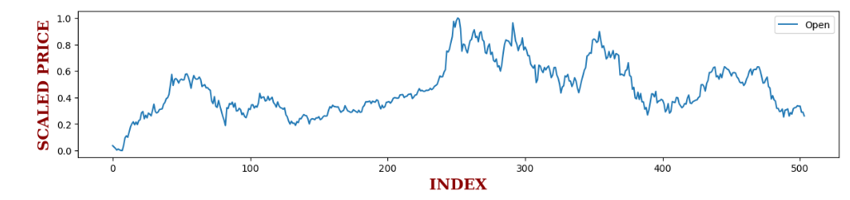
SCALED CLOSE_PRICE

Slide 11
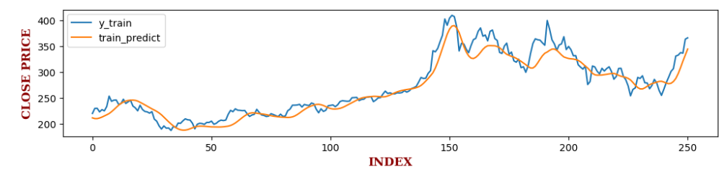
ACTUAL vs PREDICTED ON TRAIN DATA

Slide 12
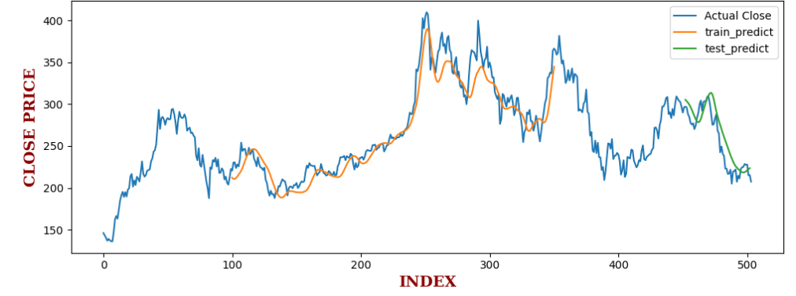
ACTUAL vs PREDICTED ON COMPLETE DATASET

Slide 13
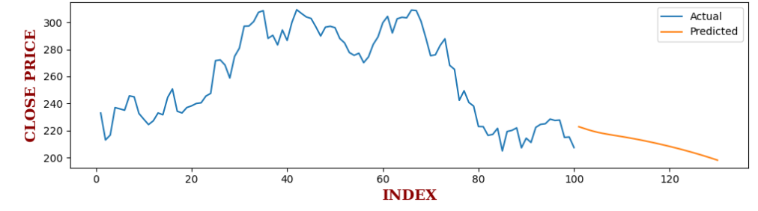
NEXT 30 - DAY PREDICTION

Slide 14
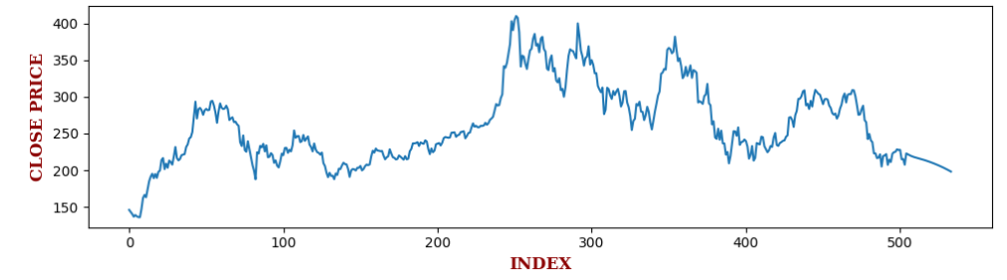
FINAL PLOT

Slide 15
Conclusion
In this project, we are predicting closing stock price of TESLA (TSLA) organization. We developed a machine learning model for predicting close stock price using LSTM algorithm.
We have applied datasets belonging to Yahoo Finance, and achieved a good predicting model with very less difference in RMSE (Root Mean Square Error) values of training and testing data.
There is still a hope of improvement in the accuracy of the model, using different tecniques and features.

Slide 16

Future Scope
Adding more parameters and factors like the financial ratios, multiple instances, etc.
The more the parameters are taken into account more will be the accuracy.
The algorithms can also be applied for analyzing the contents of public comments and thus determine patterns/relationships between the customer and the corporate employee.
In the future, we plan to integrate neural network with some other techniques that can be used to identify optimal network architecture and training parameters and the ability to account for some uncertainty produced by the neural network predictions.

Slide 17


